Slide 1

ARTIFICIAL INTELLIGENCE INT 404
AI IN PERSONAL ASSISTANT
NAME: ANKIT RAJ NAME: ADAPA PRUDHVI NAME: AKANGSHA CHAKRABORTY
REGISTRATION NO.:12114948 REGISTRATION NO.: 12115717 REGISTRATION NO.: 11900826
ROLL NO.: 36 ROLL NO.: 60 ROLL NO.: 12
Under the Guidance of Prof. Ankita Wadhawan

Slide 2

OUTLINE :
Introduction
Objectives
Use Case Diagram
Applications
Methodology
Impact
Future Scope
Conclusions

Slide 3



INTRODUCTION
👉 Virtual assistant is an application program that understands natural language and voice commands to complete tasks for the users.
👉 Virtual assistant is used to perform a typical task like showing date-time, managing emails, open apps, etc. on your command.
👉 Now a days virtual assistant is very useful to human.
👉 It makes human life easier like operate PC’s or laptop on only voice command.
👉 By using virtual assistant we saves our time and contribute in other works.

Slide 4

OBJECTIVES
The main objective of a personal assistant is to understand the user’s command, provided in either of the ways, speech or text, and respond to the command accurately in less consumption of time.
Virtual assistants can tremendously save you time. We spend hours in online research and then making the report in our terms of understanding. Your personal assistant can do that for you.
The purpose of an intelligent virtual assistant is to answer questions that users may have.
As a Virtual Assistant, It will perform various “administrative tasks” like answering emails, scheduling meetings, making travel arrangements, etc.

Slide 5
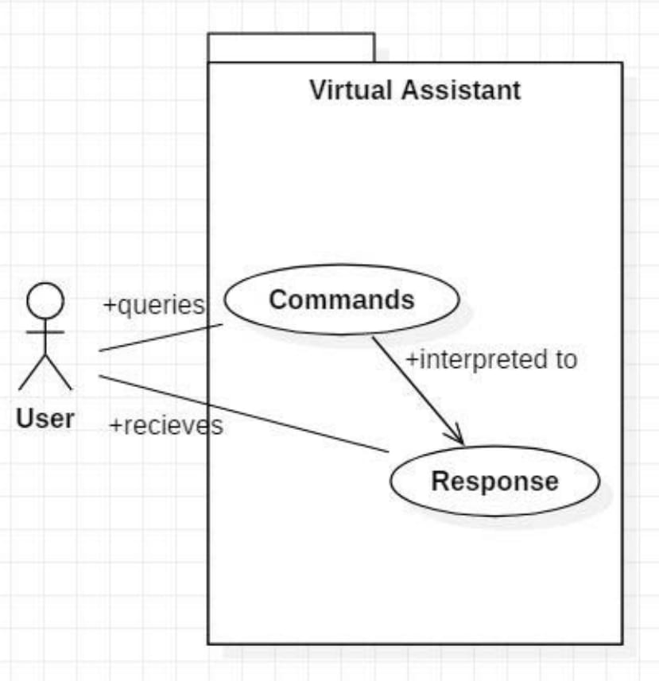
Use
Case
Diagram
The user queries a command to the system. System then interprets it and fetches answer. The response is sent back to the user.

Slide 6

APPLICATIONS OF AI IN PERSONAL ASSISTANT
Smart Homes Devices (Alexa, Google Fit etc.)
Bookkeeping
(keeping track of finances)
Personalized User Experience
Research
Administrative Work (scheduling meetings, booking ticket, etc.)
Data Entry
Customer Service

Slide 7

METHODOLOGY
🎯 The methodology of the project "AI in Personal Assistant" involves several steps that are necessary to develop and implement an intelligent system for automation. These steps include:
Requirements gathering and analysis: The first step is to identify the requirements of the intelligent system, including the functions it needs to automate, the sensors and devices that need to be integrated, and the user interfaces that will be used.
Design and prototyping: Based on the requirements gathered in the first step, the next step is to design the system architecture, algorithms, and user interfaces.
Data collection and processing: The intelligent system relies on data collected from sensors, user behavior, and other sources to make decisions and automate functions.
Machine learning and AI modelling: The intelligent system uses machine learning and AI algorithms to analyses the data and make decisions.
Integration and testing: Once the software and hardware components have been developed, they need to be integrated into a working system.
Deployment and maintenance: The final step is to deploy the system in a real-world environment and maintain it over time.

Slide 8

IMPACT
Healthcare: Virtual assistants schedule appointments and enter data into applications easily. It also aids front-office operations by accelerating admissions, discharges, transfers, scheduling patient consultations, and sending and receiving referrals with easy patient medical record updates.
Food: A virtual assistant lets you address your customers’ most frequent queries, reducing order delay time and easing your order tracking process. It provides a contactless experience for your customers, starting with the meal ordering process and ending with safe payment and delivery, offering them a seamless experience throughout.
Travel: Virtual assistants can enable you to guide your customers with trip planning, room types, food, trip notes, safety, medical information, backpacking list, climate, and seasonal information.
Notes:
https://unsplash.com/photos/TvN54bnuQg8

Slide 9

FUTURE
SCOPE
Virtual Assistant(VA) technology has a bright future ahead. In smartphones, they are already capable of scheduling tasks or answering simple questions but in near future You wouldn't need to type, perhaps not even take your phone out of your pocket. You could simply literally tell your phone to set an alarm for you, call your friend, type a message & send it, play a particular song, auto switch off at a time you need specify.
Other than smartphone industry, Virtual Assistant have a good future in medical applications, many of the surgeons and researchers are already working on the robots and robotic arms which using Virtual Assistant technology will help them in surgeries and treatment process. Google is currently working on an automated car. Many of the functions in that car will be served by Virtual Assistant only.
Notes:
https://unsplash.com/photos/GKLIsLZxhj0

Slide 10

CONCLUSION
We've covered Python-based Personal Virtual Assistants for Windows in this project. Human’s lives are made simpler by virtual assistants. An excellent virtual assistant will save time and money by doing the small tasks for you and doing them accurately and with high quality. If you handle the virtual assistant correctly, it will be a boom in your business.
The major advantage of these virtual agents is that they can undertake jobs that formerly required human expertise, allowing the human employees to offer more value to client encounters by automating routine tasks.
It will reduce workload and will do ones work in just single voice command.
More research is required to better understand the use of these devices according to our findings so far.

Slide 11


